Slide 1

Diary Management System
Kiera Cutri, Ankush Chaudhari
Sacred Heart University
The Jack Welch College of Business & Technology
CS603B – Spring 2022 – Submitted to Dr. Reza Sadeghi

Slide 2

Presentation Outline
What is the Diary Management System?
ER Diagram
EER Diagram
Tables
Tables Cont.
SQL Code
SQL Code Cont.
Programming the GUI
GUI
GUI Cont.
Conclusions and the Future
Questions
References
Image 1

Slide 3

What is it?
The Diary Management System (DMS) has been designed to benefit scholarly institutions through the creation of a localized hub which stores student, faculty, and staff data.
Allows relevant users access to building specifications, class scheduling, and student and staff availability in order to allow for easier scheduling.
User friendly interface which localizes relevant data through the click of a button
Image 2

Slide 4
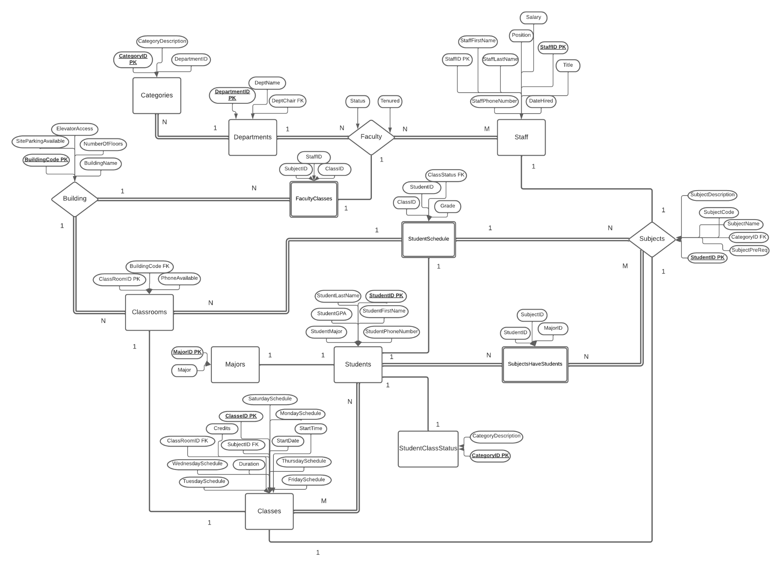
ER Diagram

Slide 5
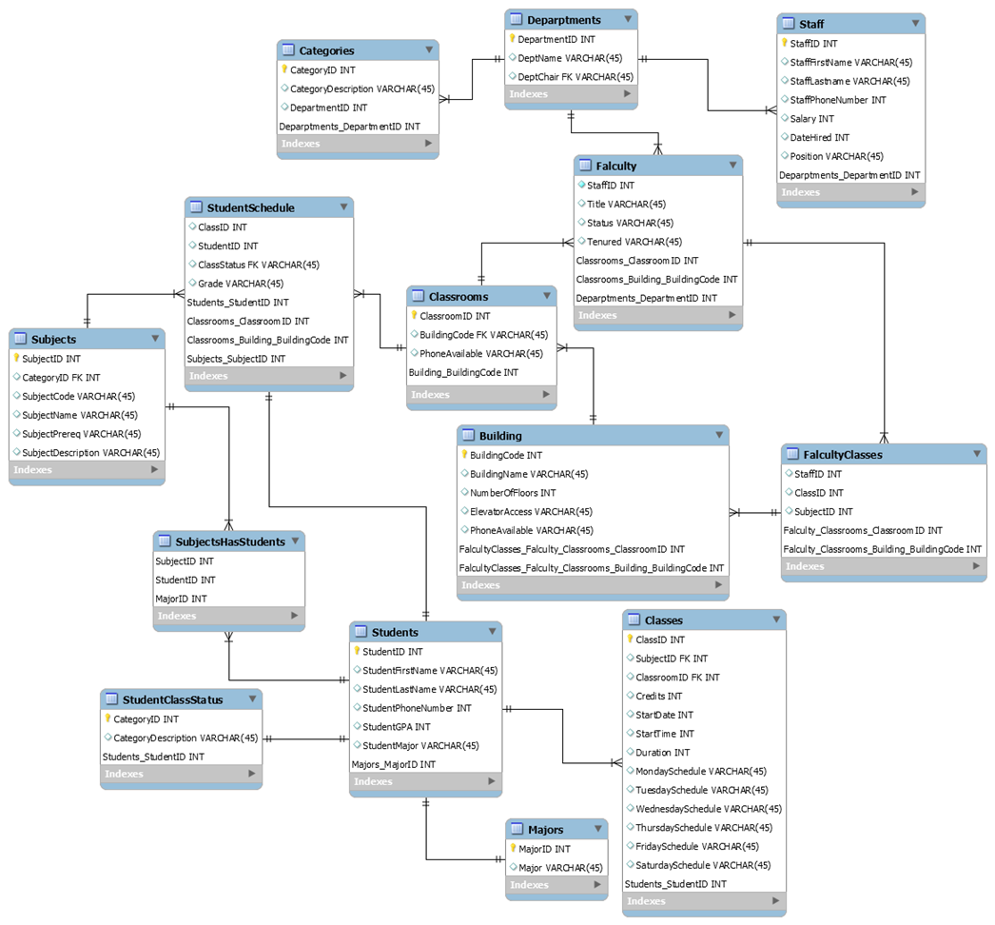
EER Diagram

Slide 6
Tables
Staff
StaffID PK
StaffFirstName
StaffLastName
StaffPhoneNumber
Salary
DateHired
Position
FacultyClasses
StaffID CPK
ClassID CPK
SubjectID CPK
SubjectsHaveStudents
SubjectID
StudentID
MajorID
Building
BuildingCode PK
BuildingName
NumberOfFloors
ElevatorAccess
SiteParkingAvailable
Subjects
SubjectID PK
CategoryID FK
SubjectCode
SubjectName
SubjectPreReq
SubjectDescription
Faculty
StaffID PK
Title
Status
Tenured
Majors
MajorID PK
Major

Slide 7
Tables Cont.
Classes
ClassID PK
SubjectID FK
ClassRoomID FK
Credits
StartDate
StartTime
Duration
MondaySchedule
TuesdaySchedule
WednesdaySchedule
ThursdaySchedule
FridaySchedule
SaturdaySchedule
StudentClassStatus
CategoryID PK
CategoryDescription
Departments
DepartmentID PK
DeptName
DeptChair FK
Students
StudentID PK
StudentFirstName
StudentLastName
StudentPhoneNumber
StudentGPA
StudentMajor
Classrooms
ClassRoomID PK
BuildingCode FK
PhoneAvailable
StudentSchedule
ClassID CPK
StudentID CPK
ClassStatus FK
Grade
Categories
CategoryID PK
CategoryDescription
DepartmentID

Slide 8
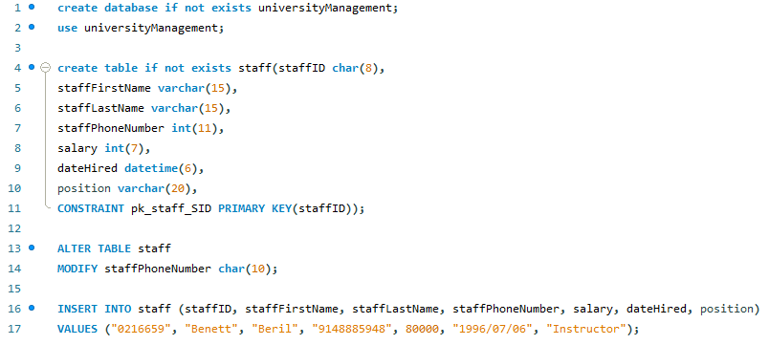
SQL Code
Database Creation, Insert Commands, and Altering Our Code

Slide 9
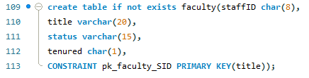
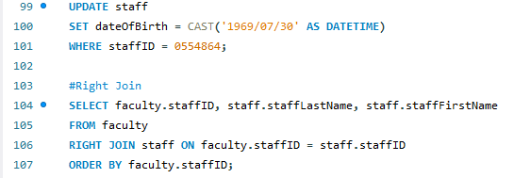
SQL Code Cont.
Update, Join, and Optimization

Slide 10
Programming the GUI
Sublime
Sublime is a commercial source code editor that natively supports multiple programming languages and markup languages
Typically community built and maintained under free-software licenses
XAMPP
XAMPP is a free, open-source cross-platform web server solution developed by Apache Friends
Uses Apache HTTP Server, MariaDB database, and interprets scripts in PHP and Perl programming languages

Slide 11
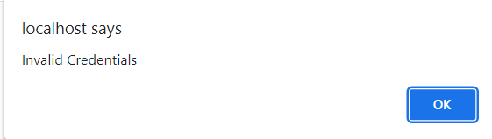
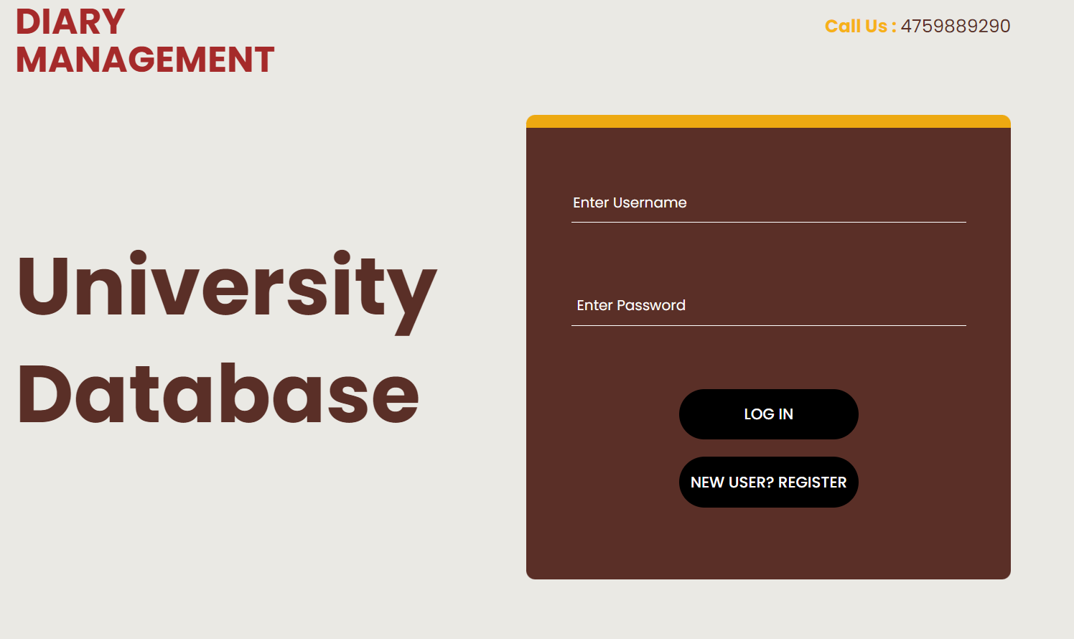
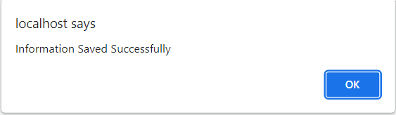
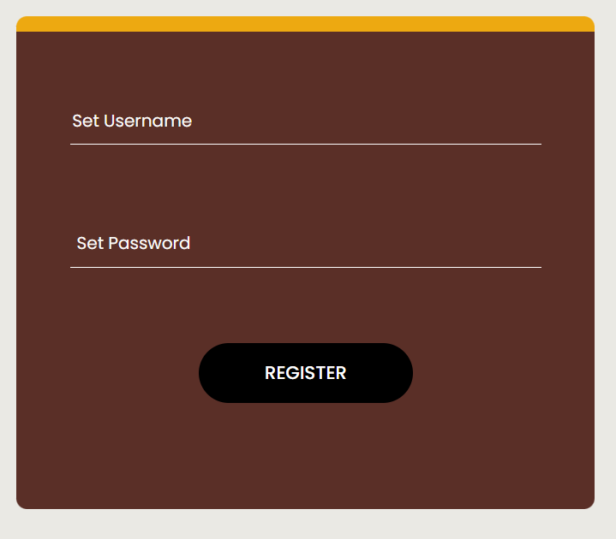
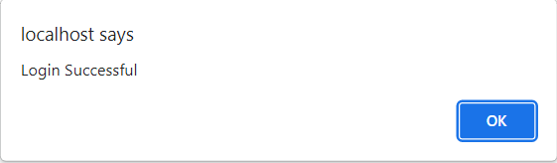

GUI
Invalid Credentials
Login
Registration Successful
Register
Login Successful
Main Hub

Slide 12
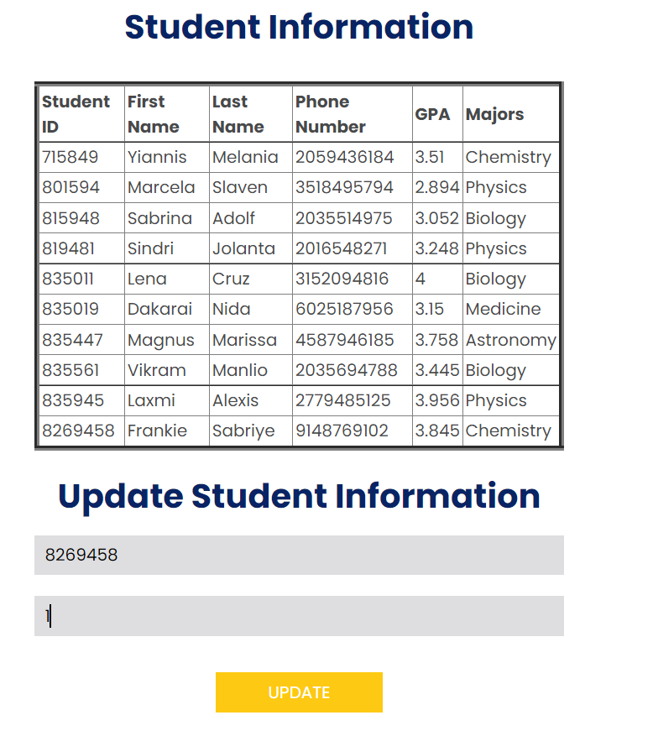

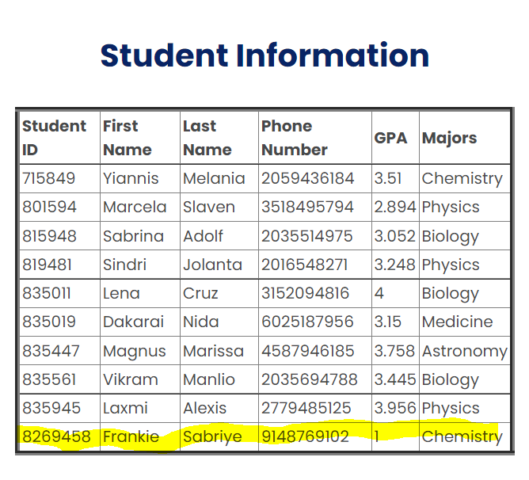
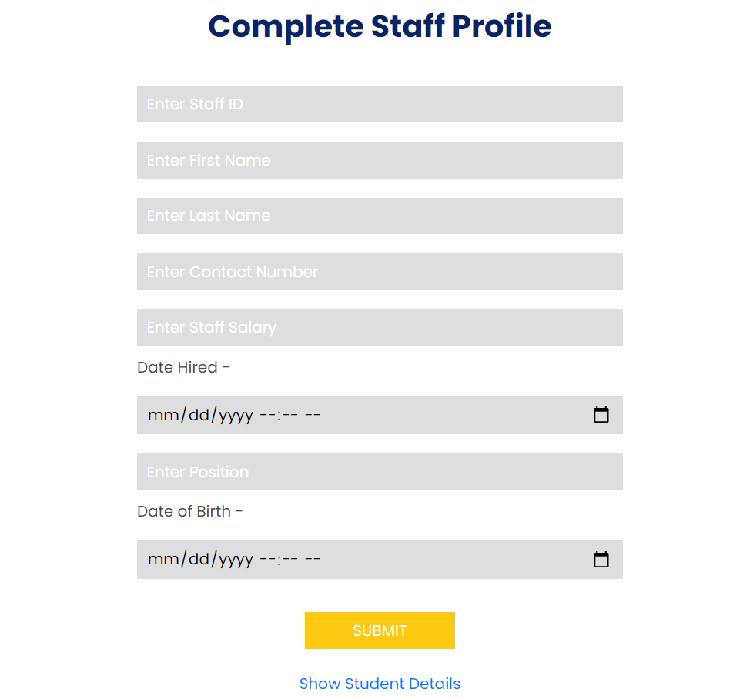
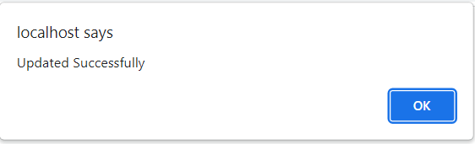
GUI Cont.
Update Record
Delete
Successful GPA Change
Add Record
Update Successful

Slide 13

Conclusions and the Future
This project has allowed us to further develop our communication skills, time management, peer review, peer accountability, the ability to delegate responsibilities, and refine our understandings of concepts through careful discussion and explanation with each other.
For the future of this project, we would like to create a fully working graphical user interface. We would also like to polish the aesthetic appearance of the application; one such way we would attempt this is by taking original photos and creating an original logo to incorporate into the application. We would like to optimize the graphical user interface to run more efficiently after having a more complete implementation. We would like to add security features to prevent malicious attacks on the database.
After moving our project from python to CSS and PHP, we were only able to collaborate locally from the XAMPP for the GUI. We would like to transfer the local instance of our GUI to a local web server for more convenient collaboration.
Improve functionality that allows for detailed comments by users outside of individual users apart of the database.
Image 3

Slide 14

Questions?
Image 4

Slide 15
References
1. Viescas, John L. “School Scheduling Modify Database Page 883.” SQL Queries for Mere Mortals: A Hands-on Guide to Data Manipulation in SQL, Pearson Technology Group Canada, 2018.
2. elinet. “Elinet.” Free Source Code, Projects & Tutorials, 11 Sept. 2014, https://www.sourcecodester.com/php/7943/online-diary-management-system.html.
3. W, Megan. “Urgent! -- Cite LudicChart – Lucidchart.” Lucidchart, 20 Sept. 2018, https://lucidchart.zendesk.com/hc/en-us/community/posts/360018227346-URGENT-Cite-LudicChart.
4. Peterson, Richard. “SQL Primary Key: How to Create & Add to Existing Table.” Guru99, 29 Jan. 2022, https://www.guru99.com/sql-server-primary-key.html.
5. “SQL FOREIGN KEY Constraint.” SQL Foreign Key Constraint, https://www.w3schools.com/sql/sql_foreignkey.asp.
6. Saba, Gulsanober, et al. “Python GUI Login - Graphical Registration and Login System in Python.” Simplified Python, 4 Mar. 2020, https://www.simplifiedpython.net/python-gui-login/.
7. “Sublime Text.” Wikipedia, Wikimedia Foundation, 9 Feb. 2022, https://en.wikipedia.org/wiki/Sublime_Text.
8. “Xampp.” Wikipedia, Wikimedia Foundation, 19 Mar. 2022, https://en.wikipedia.org/wiki/XAMPP.
Image References: Image 1. https://www.grammarly.com/blog/outlining/ Image 2. https://pngimg.com/images/objects/diary Image 3. https://www.psychologytoday.com/us/blog/innovation-you/201708/see-the-future-first Image 4. https://www.pinclipart.com/maxpin/iTombmi/

